Slide 1
Scaling II: Rollup
CS251 Fall 2021
(cs251.stanford.edu)
Benedikt Bünz

Slide 2

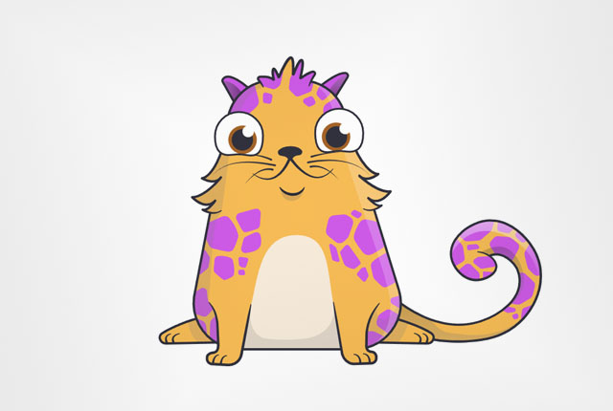
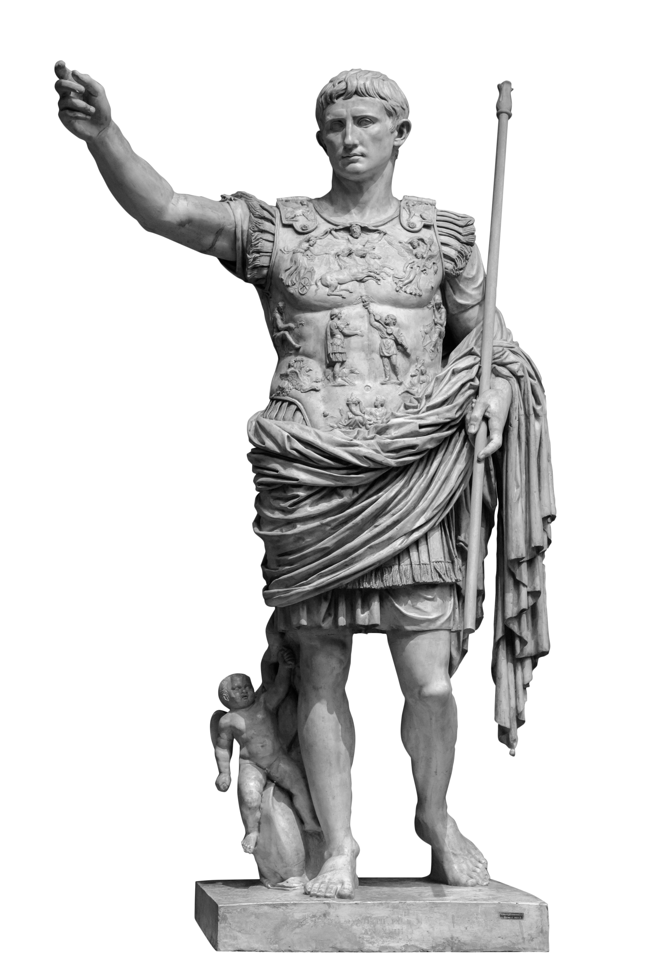
Lightning network
Low TX fees
Instant payments
Routing through intermediaries

Slide 3
Downsides of Payment/State Channels
Everyone needs to be online
Mitigated by watchtowers
Hubs need to be online
Capital is locked up
Funds in one channel can’t be used in different channel
If network is separated transactions are not possible
Only Peer to Peer payments
No multi party contracts channels
TX to fund/close

Slide 4
Blockchain Layers
Layer 3:
user facing tools (cloud servers)
Layer 2:
applications (DAPPs, smart contracts)
Layer 1.5:
compute layer (blockchain computer)
Layer 1:
consensus layer
Bitcoin/Ethereum combine ordering (layer 1) and verification (1.5)
What if we can outsource verification? Makes consensus cheaper

Slide 5
Idea: Aggregate Transactions
Payment channels move more transactions offchain
Idea: Combine Transaction, Rollup Server verifies
TX1:
A->B 5ETH
TX Agg:
TX1,TX2,TX3
Smaller than sum of TX
TX2:
C->D 2ETH
TX3:
D->B 1ETH
Server (untrusted)
Blockchain

Slide 6
Recap: The Ethereum blockchain
prev hash
prev hash
…
…
accts.
accts.
updated world state
Tx
log messages
updated world state
Tx
log messages

Slide 7
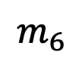
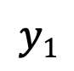
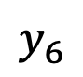
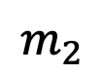
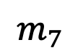
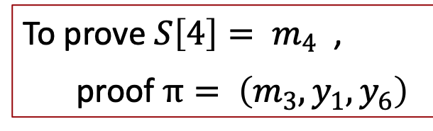
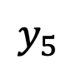
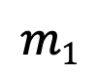
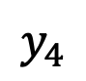
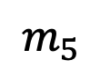
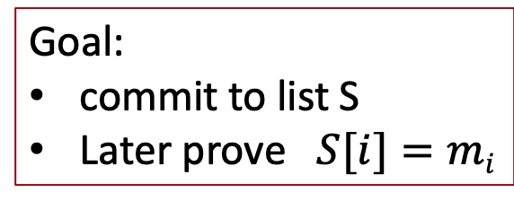
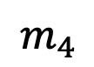
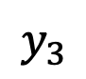

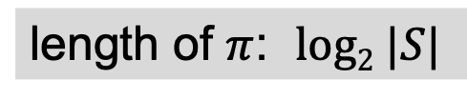
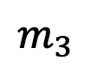
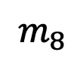
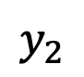
Recap: Merkle tree (Merkle 1989)
commitment
$$h$$
Goal:
commit to list S
Later prove $S[i]=mi$
$$y_{5}$$
H
$$y_{6}$$
H
H
$$y1$$
$$y_{2}$$
$$y_{3}$$
$$y_{4}$$
To prove ${S\left[4\right]= m}_{4}$ ,
proof $π= \left(m_{3}, y_{1}, y_{6}\right)$
H
H
H
H
$$m1$$
$$m_{2}$$
$$m_{3}$$
$$m_{4}$$
$$m_{5}$$
$$m_{6}$$
$$m_{7}$$
$$m_{8}$$
length of $π$: $log2 |S|$
list of values S

Slide 8
Recap State Commitment
Every contract has an associated storage array S[]:
S[0], S[1], … , S[2²⁵⁶-1]: each cell holds 32 bytes, init to 0.
Account storage root: Merkle Patricia Tree hash of S[]
Cannot compute full Merkle tree hash: 2²⁵⁶ leaves
0
0, a
S[000] = a
S[010] = b
S[011] = c
S[110] = d
time to compute root hash:
≤ 2×|S|
0
0
⊥, b
root
1
1
10, d
1
⊥, c
|S| = # non-zero cells
Notes:
Store suffix in nodes.

Slide 9
Merke (Patricia) Tree Proofs
Logarithmic in tree height
Given proof for i -> Possible to update S[i] and recompute root
Given proof for i, proof for j and update of S[j] it’s possible to update proof for S[i]
Exclusion proofs possible in Patricia Trees

Slide 10
Rollup
Users
Server
Rollup Smart Contract
Rollup State S
Stores S
S[A’s PK] = {3 ETH, nonce}
S[B’s PK] = {2 ETH, nonce}
S[C’s PK] = {10 ETH, nonce}
S[D’s PK] = {1 ETH, nonce}
0
0, a
0
0
⊥, b
root
1
1
10, d
1
⊥, c

Slide 11
Rollup Deposit
TX Deposit
Users
Rollup Smart Contract
root
TX Deposit:
Proof that A’s PK ∉ S given
3 ETH transfer
Checks Proof
Updates root such that S[A’s PK]={3 ETH, 0}
root

Slide 12
Rollup Withdraw
TX Withdraw
Users
Rollup Smart Contract
root
TX Withdraw:
Proof that S[A’s PK]={3 ETH, nonce} given
Destination Address NewA
Signature by A
Checks Proof
Checks Signature
Sends 3 ETH to NewA
root

Slide 13
Rollup Transfer
Space saved but no computation
TX Transfer
Users
Rollup Smart Contract
root
TX Transfer:
Checks Proofs
Checks Signature
Set
S[A’s PK]={1 ETH, 1}
S[B’s PK]={4 ETH, 1}
Proof that given
S[A’s PK]={3 ETH, 0}
S[B’s PK]={2 ETH, 0}
Transfer amount 2 ETH
Signature by A
root

Slide 14
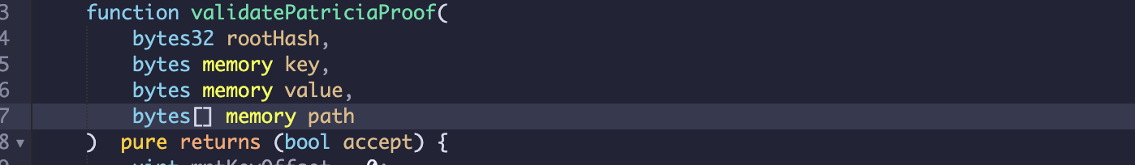
SNARK
Provides Proof/SNARK that given given public inputs (rootHash, key, value) it knows private inputs (path) such that function outputs true
SNARK is short/easy to check

Slide 15
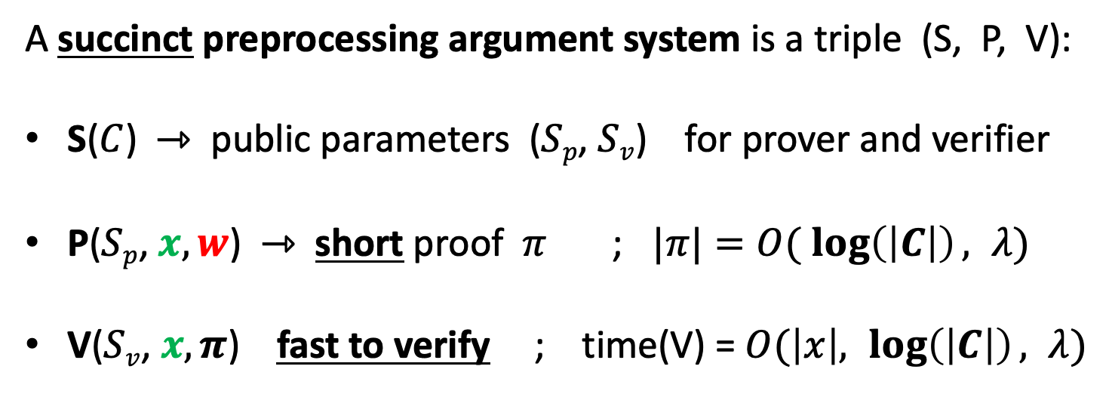
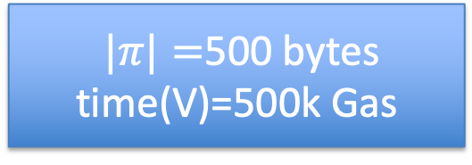
SNARK: a Succinct ARgument of Knowledge
A succinct preprocessing argument system is a triple (S, P, V):
S($C$) ⇾ public parameters ($Sp$, $Sv$) for prover and verifier
P($Sp$, $x, w$) ⇾ short proof $π$ ; $|π|=O( \log\left(\left|C\right|\right), λ)$
V($Sv$, $x, π$) fast to verify ; time(V) = $O(\left|x\right|, \log\left(\left|C\right|\right), λ)$
$|π|=$500 bytes
time(V)=500k Gas
If (S, P, V) is succinct and zero-knowledge then we say that it is a zk-SNARK

Slide 16
ZKRollup
Merkelize Transactions
SNARK proves that given transactions I know signatures such that state transition S -> S’ valid
Publish transaction diff on chain.
No signatures per transaction.
500k gas + data cost for on chain diff

Slide 17
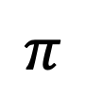
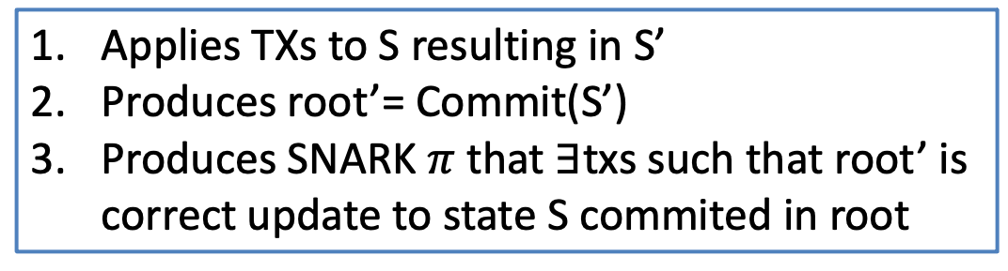
ZKRollup (Validity Rollup)
Users
root’
$$π$$
Transactions
Server
Stores S
Rollup Smart Contract
Coordinator does:
root
Applies TXs to S resulting in S’
Produces root’= Commit(S’)
Produces SNARK $π$ that $∃$txs such that root’ is correct update to state S commited in root
Commitment to S

Slide 18
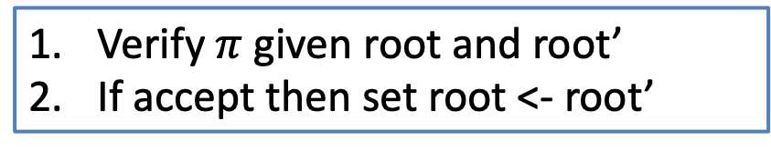
ZKRollup
Users
root’
$$π$$
Transactions
Server
Stores S’
Rollup Smart Contract
Smart Contract does:
root’
Verify $π$ given root and root’
If accept then set root <- root’
Commitment to S
Smart contract still allows “manual” withdrawals

Slide 19

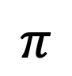
Data Availability Problem
⁇
root’
$$π$$
Update must be valid!
What if Server does not reveal data?
Can’t update Merkle proofs
Can’t withdraw!

Slide 20
Publish diff on chain
Users
Server
root’
$$π$$
Transactions with signatures
txlist
Stores S’
Rollup Smart Contract
root’
Txlist= [{A-> B 3}, {C-> D 2}, {D-> B 1}]
No signatures, Sender, Receiver, Amount only in Calldata (not stored)
<100bytes per tx ~400 gas/tx, SNARK verification ~1500 gas/tx (if full)
Full Block 3600 rollup tx vs 570 normal tx (6x speedup)

Slide 21
zkRollup stats
ZKRollup is cheaper than onchain tx
Can scale to max ~300tx/s now, 1000tx/s soon
Vs. max 40-50tx/s on mainnet
Cost dominated by SNARK verification
Will get cheaper precompiles
Finality ~ Blockchain finality (no instant transfer)

Slide 22
Multiple Assets
Very easy to support many assets
Simply add asset field to TX
Hardly increases SNARK complexity
Txlist= [{A-> B 3 ETH}, {C-> D 2 DAI}, {D-> B 1 BAT}]
1 byte → 256 assets
2 bytes→ 65k assets

Slide 23
Transaction List/Atomic Swaps
Support transaction list that are executed together
Transactions need to be signed by all senders
Can’t execute part of transaction only all together!
Enables atomic swaps: Alice swaps with Bob 3 ETH for 2 DAI
Txlist= [{A-> B 3 ETH and B-> A 2 DAI}, {D-> B 1 BAT}]

Slide 24

Exchanges
Buy 3 ETH for 5 DAI
Exchanges match orders
Classical exchanges
also store funds
Sell 3 ETH for 5 DAI
Order book
give
get
Alice | 3 | ETH | 5 | DAI
Bob | 5 | DAI | 3 | ETH
Carol | 4 | BAT | 10 | DAI

Slide 25
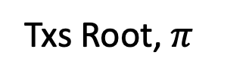
Rolled up Exchange
Txs Root, $π$
Submit orders
Verifies TX
Has orderbook
Matches orders
Rolls up transactions as atomic swaps
Root of balance tree
Exchange trusted for honest matching

Slide 26
Rolled up Exchange v2
Txs Root, $π$
Submit orders
Verifies TX
Updates orderbook tree on chain and proves correct matching
Root of balance tree
Root of orderbook tree
Benefit: No trust
Downside: Every order creates rollup TX, No instant matching

Slide 27
Rolling up Smart Contracts
zkRollup works best for simple transfers
zkRollup for the EVM?
Roll up generic smart contract transactions?
Create SNARK where the circuit implements the EVM
More expensive on the server
Soon to be a reality for a subset of the EVM (zkEVM)
Can we support smart contract rollups today?

Slide 28
Optimistic Rollup
Users
root’
$$π$$
Transactions with signatures
Server
txlist
Stores S’
Rollup Smart Contract
root’
What if we remove the SNARK?
Idea: Instead of proving correctness, prove fraud!
New Role: Validator checks correctness, provides fraud proofs

Slide 29
Optimistic Rollup
Server updates transaction root
Server puts a large bond into escrow
If transaction update is invalid users/validators provide fraud proof
Successful fraud proof means bond gets slashed
Part to validator providing proof part gets burned
Unsuccessful fraud proof costs validator money
How to proof fraud?

Slide 30
Fraud Proofs
root
Commits to state S
Validator
txlist
Server
Stores S agrees on root
Applies txlist to S to compute S’
Computes root’’ from S’
If root’≠root’’ call “Fraud”
root’
Problem: Validator doesn’t know what’s in root’

Slide 31
Referee Delegation
Idea: Server and Validator find first point of disagreement
Break down computation of S’ into small steps, e.g. cycles on a VM
Validator does the same
Let S_{i} be Server’s intermediate states and S’_{i} the validator’s
root
txlist
root’
S₁
S₂
Computation
S_{n-1}

Slide 32
Referee Delegation
Server and Validator run interactive binary search
S_{n/2}
Checks whether
S_{n/2}=S’_{n/2}
If no disagreement in fist half
Otherwise in second
root
txlist
root’
S_{n-1}
S₁
S₂
Computation
S_{n}

Slide 33
Referee Delegation
Repeat protocol for log₂(n) steps
End with agreement on S_{i} and disagreement on S_{i+1} and S’_{i+1}
Smart Contract checks transition between S_{i} and S_{i+1} and declares winner
root
txlist
S₁
S₂
S_{n/2-1}
S_{n/2}

Slide 34
Problem: Checks take a long time
log₂(n) messages (1 hash per message)
1 Verification step on smart contract
If either party timeouts declares winner
Looser gets slashed, Winner rewarded
Problem: log₂(n)*timeout
No incentive to cheat
But: Long wait till finalization! (7 days)

Slide 35
Pipelined Assertions
Bond i
Bond i+1
Bond i+2
Rollup state i
Rollup state i+1
Rollup state i+2
Server can build on states before timeouts
If prior state invalid, all subsequent bonds are slashed

Slide 36
Pipelined Assertions
State i valid
Bond i
Bond i+1
Bond i+2
Rollup state i
Rollup state i+1
Rollup state i+2
State i not valid
Server can claim prior state not valid and continue given this.
Bond i+1
Rollup state i+1’
If no successful fraud proof then reward gets slashed

Slide 37
Insurance of Rollup -> Instant Finality
Rollup is not instant (unlike lightning)
But if server is trusted then giving them transaction -> finality
Idea: Use insurance to achieve finality
Server signs insurance
If transaction not included in next (few) blocks insurance can be used to get insurance premium
Works for zk and optimistic rollup
Does not work for NFTs (directly)

Slide 38
Optimistic Rollup
Live and implemented (Optimism and Arbitrum)
You can port arbitrary smart contracts (OVM)
Works well if honest rollup server
Fraud proofs protection if malicious server
Up to ~4000 tx/s on ETH 1.0
Important that one independent validator exists
7 day finality wait

Slide 39
A combined view of rollups
Standard L1 chains: every miner must verify every posted Tx
verify π
verify all Tx
verify all Tx ⇒ short proof π
verify all Tx
verify π
verify π
verify all Tx
Tx summary, π
rollup server
Rollup server: compresses a thousand Tx into one on-chain proof (SNARK or Fraud)

Slide 40
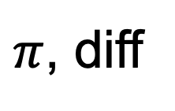
Data Availability
root’
$π$, diff
Can we keep the data off chain?
Update must be valid!
User must know state transition
Posting state diff on chain limits rollup benefits

Slide 41

Off Chain Rollups (Validum and Plasma)
Idea: Create a separate “cheap” chain for the data
Gets state/ Sends tx
User
Post new state root/ rollup proof
POS Consensus chain
Stores roll up state
Independent of #TX
Ethereum: Stores state root

Slide 42
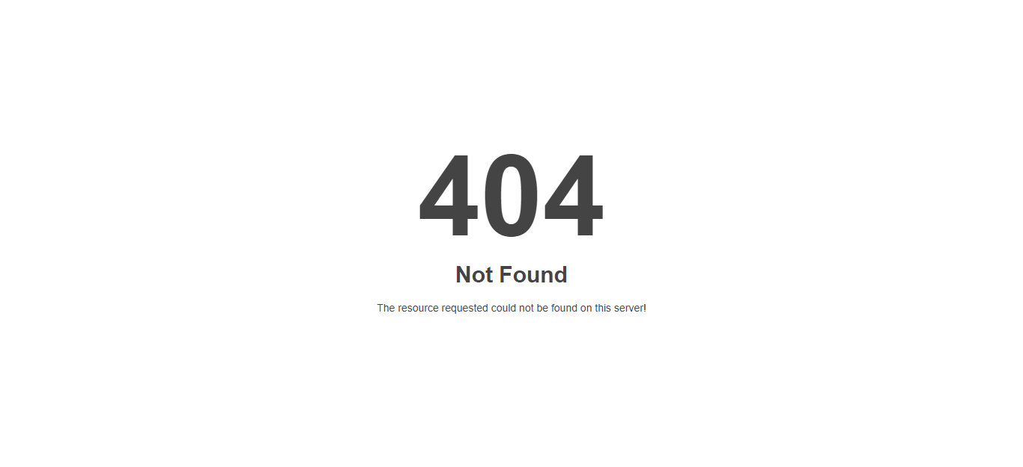
Conflict Resolution: On Chain requests
Idea: Create a separate “cheap” chain for the data
State challenge
State request
User
POS Consensus chain
Stores roll up state
Respond with state/
Slashed if no response
Ethereum: Stores state root

Slide 43
On Chain vs Off Chain Data availability
Off Chain is much cheaper and independent of #tx
Only limitation is data consensus
Data consensus not trusted for security
Can’t steal your money
Data consensus is trusted for availability
Can lock up your money (bribery attack)
Can increase fees
Economic incentives can mitigate issues
For high value transfer use on chain rollup for low value use off chain rollup

Slide 44
2 by 2 rollup
Scaling the blockchain: Payment channels and Rollups (L2 scaling)
 | SNARK validity proofs | Fraud proofs
Tx summary on L1 chain | zkRollup blockchain finality, only simple transfers (now) | optimistic Rollup 7 day finality Instant transfers
Tx summary off chain | Vallidium large #tx but vulnerable to lock up attacks | ”Plasma” Largest #tx but lock up attacks and long finality
security
availability

Slide 45
END OF LECTURE
Next lecture: Recursive SNARKs

